Slide 1
COT5615: Math for Intelligent Systems I
Anand Rangarajan
Lecture 15

Slide 2
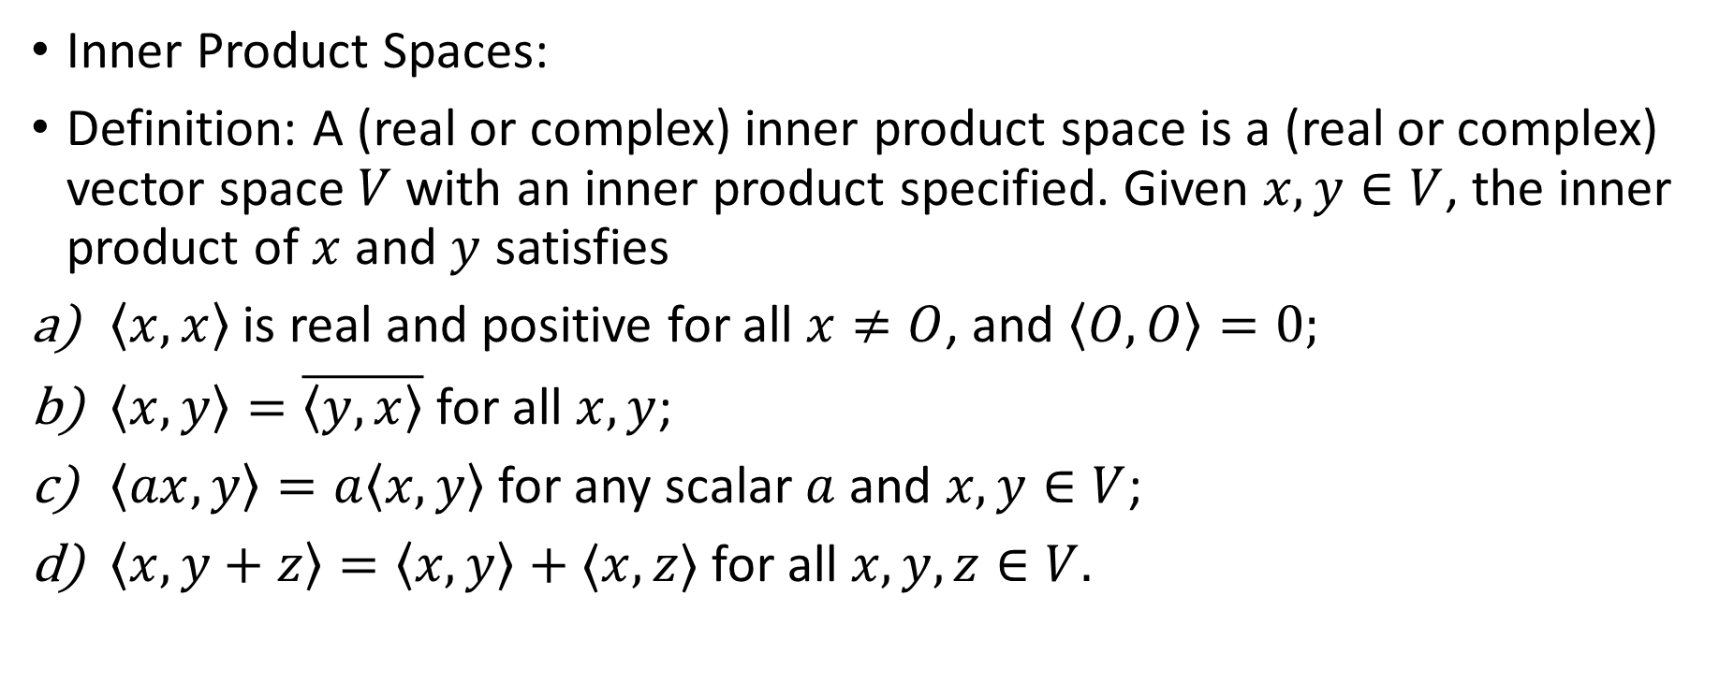
Introduction to Hilbert Spaces
Inner Product Spaces:
Definition: A (real or complex) inner product space is a (real or complex) vector space $V$ with an inner product specified. Given $x,y∈V$, the inner product of $x$ and $y$ satisfies
$\left\langle x,x\right\rangle$ is real and positive for all $x≠O$, and $\left\langle O,O\right\rangle =0;$
$\left\langle x,y\right\rangle =\overline{\left\langle y,x\right\rangle }$ for all $x,y$;
$\left\langle ax,y\right\rangle =a\left\langle x,y\right\rangle$ for any scalar $a$ and $x,y∈V$;
$\left\langle x,y+z\right\rangle =\left\langle x,y\right\rangle +⟨x,z⟩$ for all $x,y,z∈V.$

Slide 3
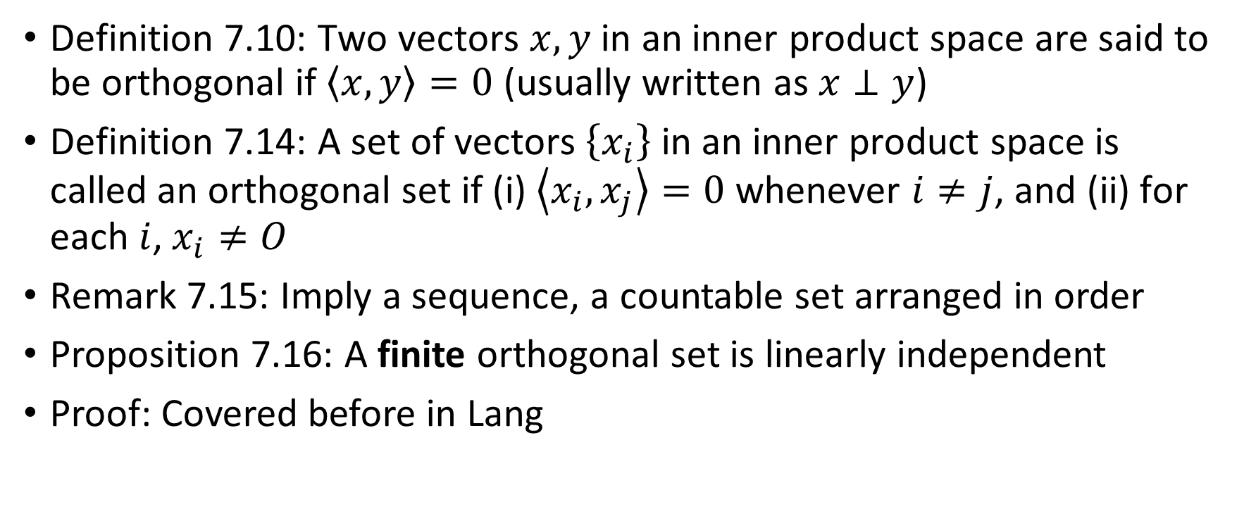
Orthogonality
Definition 7.10: Two vectors $x,y$ in an inner product space are said to be orthogonal if $\left\langle x,y\right\rangle =0$ (usually written as $x⊥y$)
Definition 7.14: A set of vectors $\left\{x_{i}\right\}$ in an inner product space is called an orthogonal set if (i) $\left\langle x_{i},x_{j}\right\rangle =0$ whenever $i≠j$, and (ii) for each $i$, $x_{i}≠O$
Remark 7.15: Imply a sequence, a countable set arranged in order
Proposition 7.16: A finite orthogonal set is linearly independent
Proof: Covered before in Lang

Slide 4
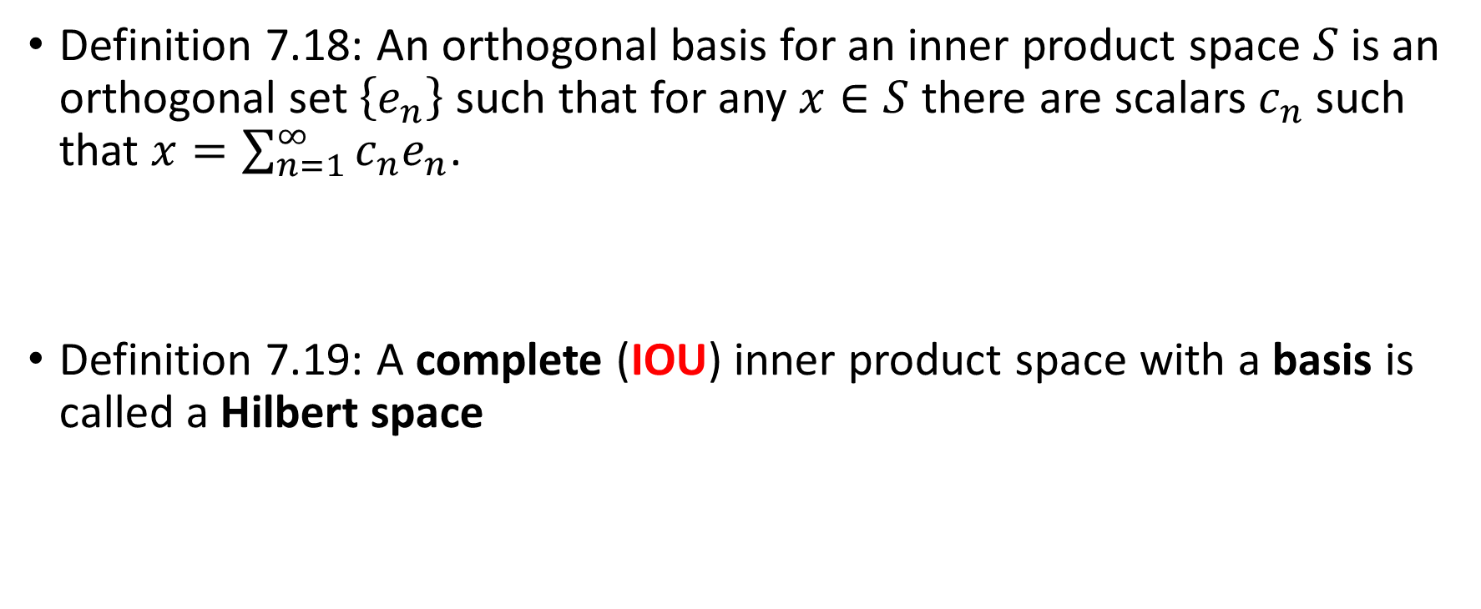
Basis
Definition 7.18: An orthogonal basis for an inner product space $S$ is an orthogonal set $\left\{e_{n}\right\}$ such that for any $x∈S$ there are scalars $c_{n}$ such that $x=\sum_{n=1}^{∞}{c_{n}e_{n}}$.
Definition 7.19: A complete (IOU) inner product space with a basis is called a Hilbert space

Slide 5
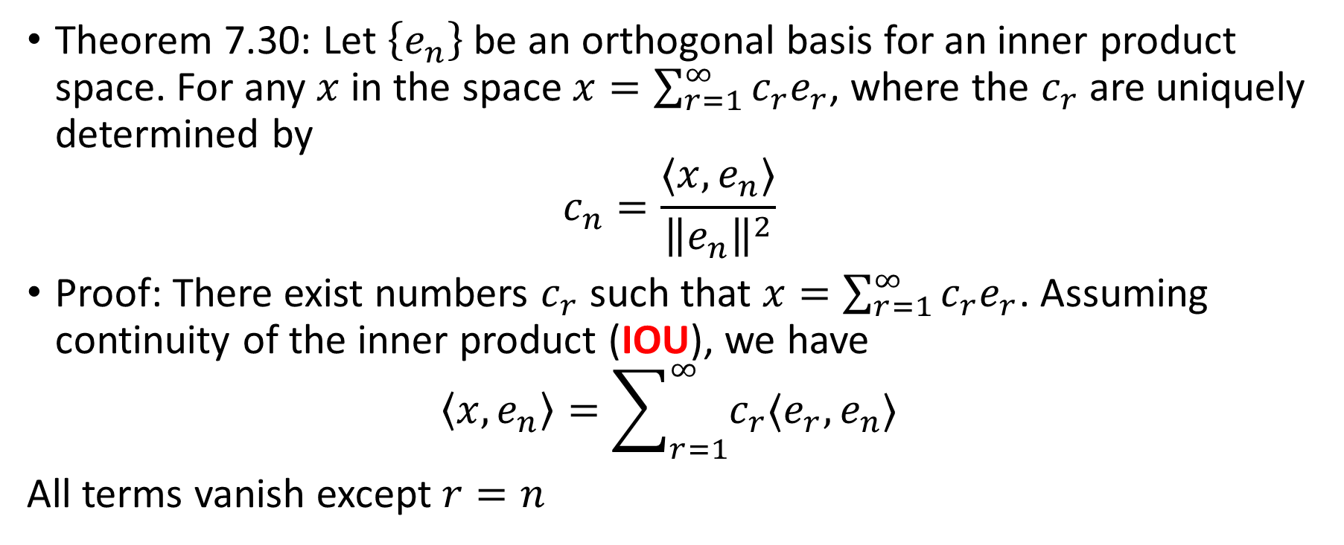
Basis coefficients
Theorem 7.30: Let $\left\{e_{n}\right\}$ be an orthogonal basis for an inner product space. For any $x$ in the space $x=\sum_{r=1}^{∞}{c_{r}e_{r}}$, where the $c_{r}$ are uniquely determined by
$$c_{n}=\frac{⟨x,e_{n}⟩}{{\left\|e_{n}\right\|}^{2}}$$
Proof: There exist numbers $c_{r}$ such that $x=\sum_{r=1}^{∞}{c_{r}e_{r}}$. Assuming continuity of the inner product (IOU), we have
$$\left\langle x,e_{n}\right\rangle =\sum_{r=1}^{∞}{c_{r}⟨e_{r},e_{n}⟩}$$
All terms vanish except $r=n$

Slide 6
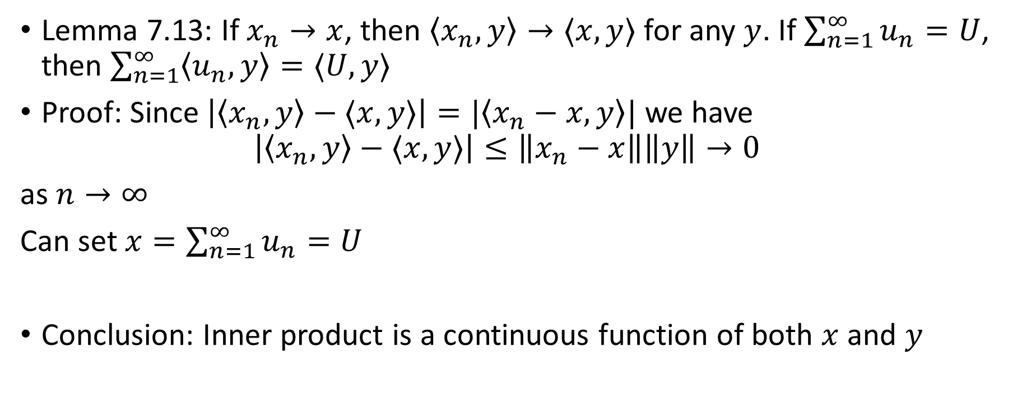
*Continuity of inner product
Lemma 7.13: If $x_{n}→x$, then $\left\langle x_{n},y\right\rangle →⟨x,y⟩$ for any $y$. If $\sum_{n=1}^{∞}{u_{n}}=U$, then $\sum_{n=1}^{∞}{\left\langle u_{n},y\right\rangle =⟨U,y⟩}$
Proof: Since $\left|\left\langle x_{n},y\right\rangle −⟨x,y⟩\right|=|\left\langle x_{n}−x,y\right\rangle |$ we have
$$\left|\left\langle x_{n},y\right\rangle −⟨x,y⟩\right|≤\left\|x_{n}−x\right\|\left\|y\right\|→0$$
as $n→∞$
Can set $x=\sum_{n=1}^{∞}{u_{n}}=U$
Conclusion: Inner product is a continuous function of both $x$ and $y$

Slide 7
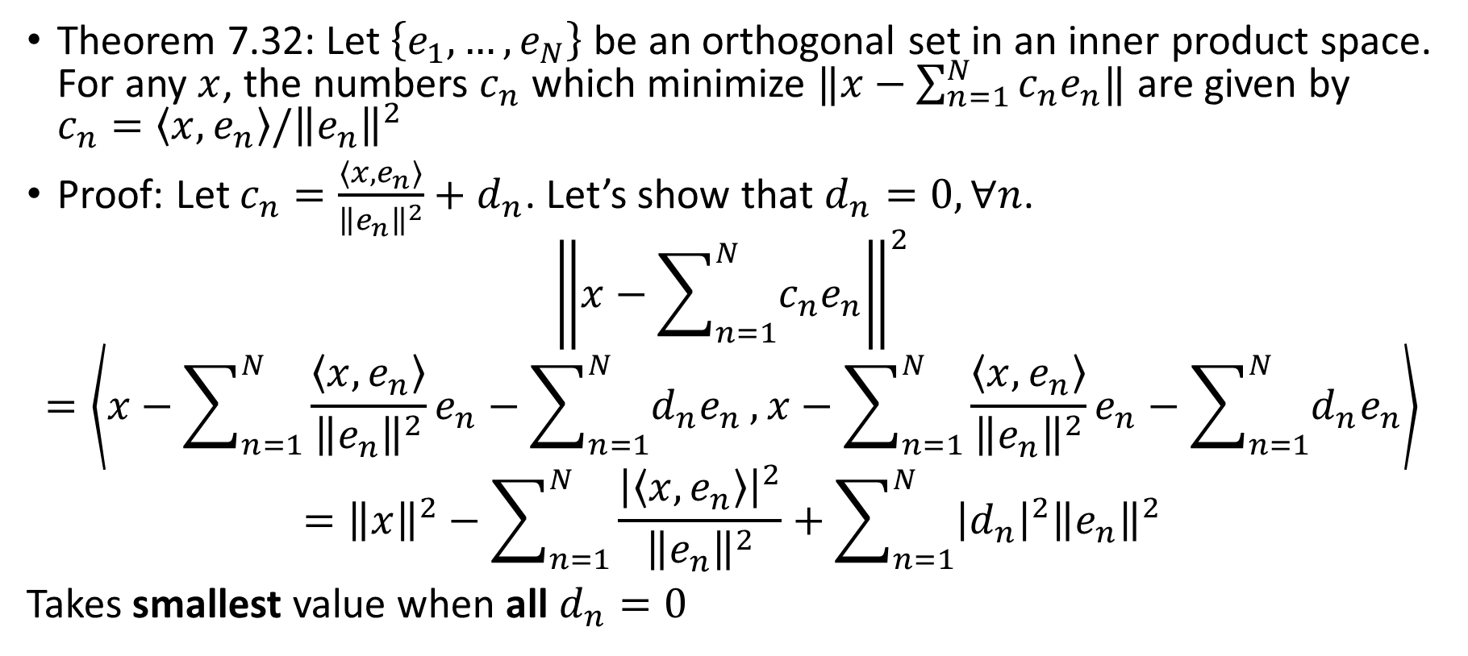
Best Approximation
Theorem 7.32: Let $\left\{e_{1},…,e_{N}\right\}$ be an orthogonal set in an inner product space. For any $x$, the numbers $c_{n}$ which minimize $‖x−\sum_{n=1}^{N}{c_{n}e_{n}‖}$ are given by $c_{n}=\left\langle x,e_{n}\right\rangle /{\left\|e_{n}\right\|}^{2}$
Proof: Let $c_{n}=\frac{⟨x,e_{n}⟩}{{\left\|e_{n}\right\|}^{2}}+d_{n}$. Let’s show that $d_{n}=0, ∀n$.
$${\left\|x−\sum_{n=1}^{N}{c_{n}e_{n}}\right\|}^{2}$$
$$=\left\langle x−\sum_{n=1}^{N}{\frac{\left\langle x,e_{n}\right\rangle }{{\left\|e_{n}\right\|}^{2}}e_{n}−\sum_{n=1}^{N}{d_{n}e_{n}}},x−\sum_{n=1}^{N}{\frac{\left\langle x,e_{n}\right\rangle }{{\left\|e_{n}\right\|}^{2}}e_{n}−\sum_{n=1}^{N}{d_{n}e_{n}}}\right\rangle$$
$$={\left\|x\right\|}^{2}−\sum_{n=1}^{N}{\frac{{\left|\left\langle x,e_{n}\right\rangle \right|}^{2}}{{\left\|e_{n}\right\|}^{2}}}+\sum_{n=1}^{N}{{\left|d_{n}\right|}^{2}{\left\|e_{n}\right\|}^{2}}$$
Takes smallest value when all $d_{n}=0$

Slide 8
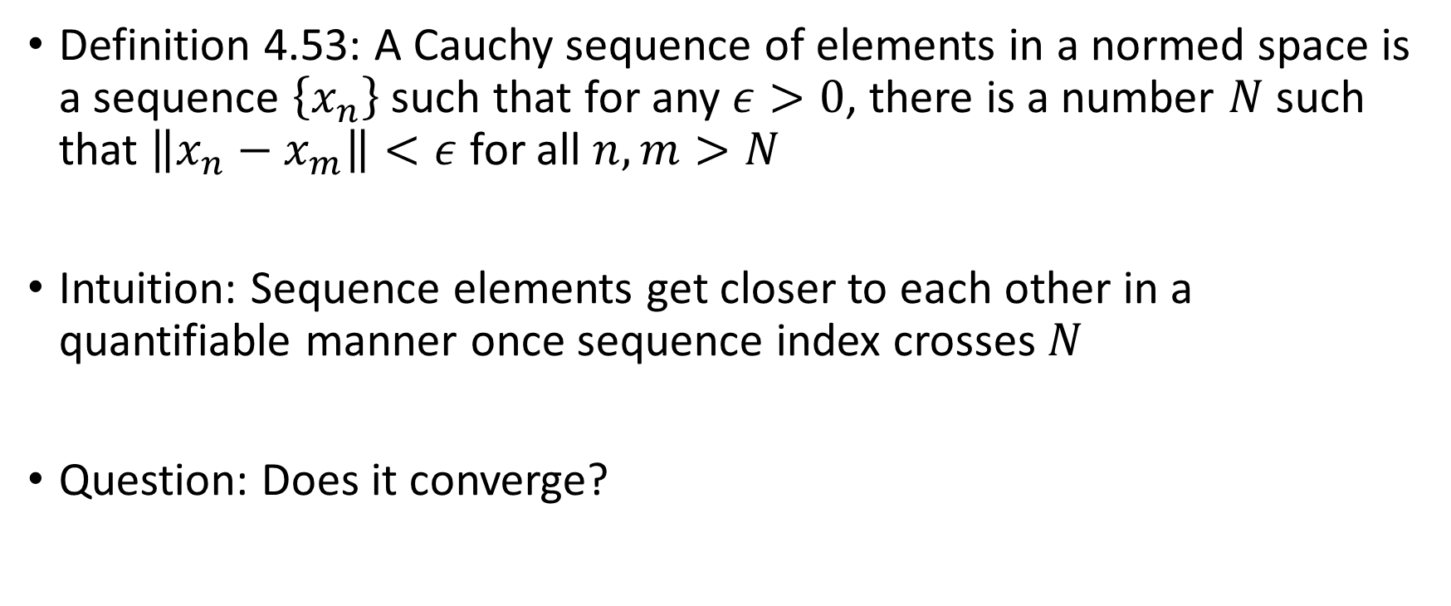
Cauchy sequence
Definition 4.53: A Cauchy sequence of elements in a normed space is a sequence $\left\{x_{n}\right\}$ such that for any $ε>0$, there is a number $N$ such that $\left\|x_{n}−x_{m}\right\|<ε$ for all $n,m>N$
Intuition: Sequence elements get closer to each other in a quantifiable manner once sequence index crosses $N$
Question: Does it converge?

Slide 9
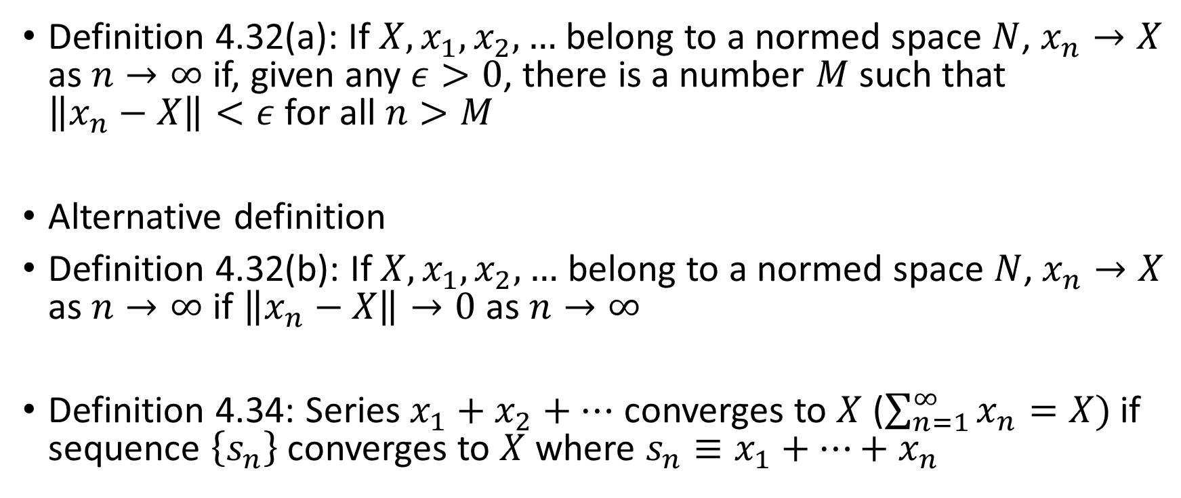
Convergence
Definition 4.32(a): If $X,x_{1},x_{2},…$ belong to a normed space $N$, $x_{n}→X$ as $n→∞$ if, given any $ε>0$, there is a number $M$ such that $\left\|x_{n}−X\right\|<ε$ for all $n>M$
Alternative definition
Definition 4.32(b): If $X,x_{1},x_{2},…$ belong to a normed space $N$, $x_{n}→X$ as $n→∞$ if $\left\|x_{n}−X\right\|→0$ as $n→∞$
Definition 4.34: Series $x_{1}+x_{2}+…$ converges to $X$ ($\sum_{n=1}^{∞}{x_{n}=X})$ if sequence $\left\{s_{n}\right\}$ converges to $X$ where $s_{n}≡x_{1}+…+x_{n}$

Slide 10
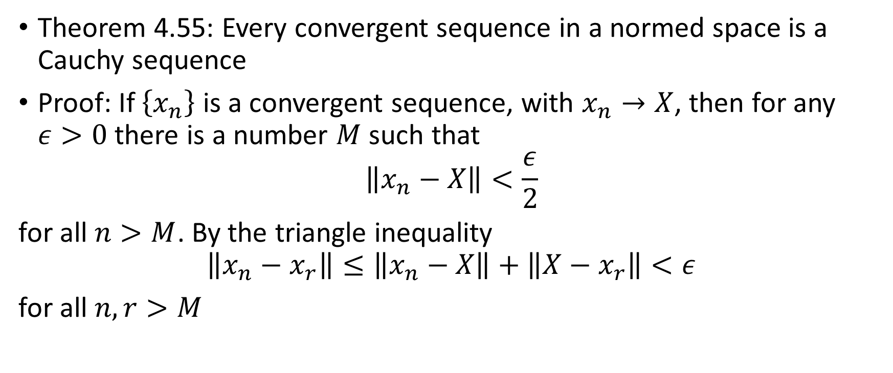
Convergent sequences
Theorem 4.55: Every convergent sequence in a normed space is a Cauchy sequence
Proof: If $\left\{x_{n}\right\}$ is a convergent sequence, with $x_{n}→X$, then for any $ε>0$ there is a number $M$ such that
$$\left\|x_{n}−X\right\|<\frac{ε}{2}$$
for all $n>M$. By the triangle inequality
$$\left\|x_{n}−x_{r}\right\|≤\left\|x_{n}−X\right\|+\left\|X−x_{r}\right\|<ε$$
for all $n,r>M$

Slide 11
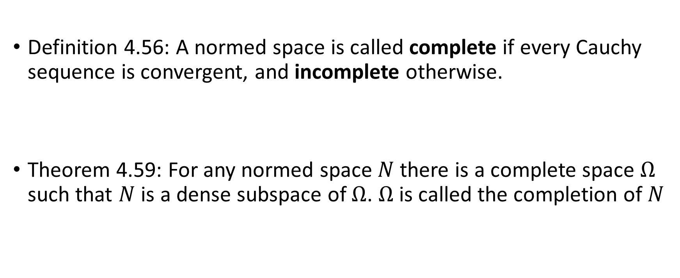
Complete Spaces
Definition 4.56: A normed space is called complete if every Cauchy sequence is convergent, and incomplete otherwise.
Theorem 4.59: For any normed space $N$ there is a complete space $Ω$ such that $N$ is a dense subspace of $Ω$. $Ω$ is called the completion of $N$

Slide 12
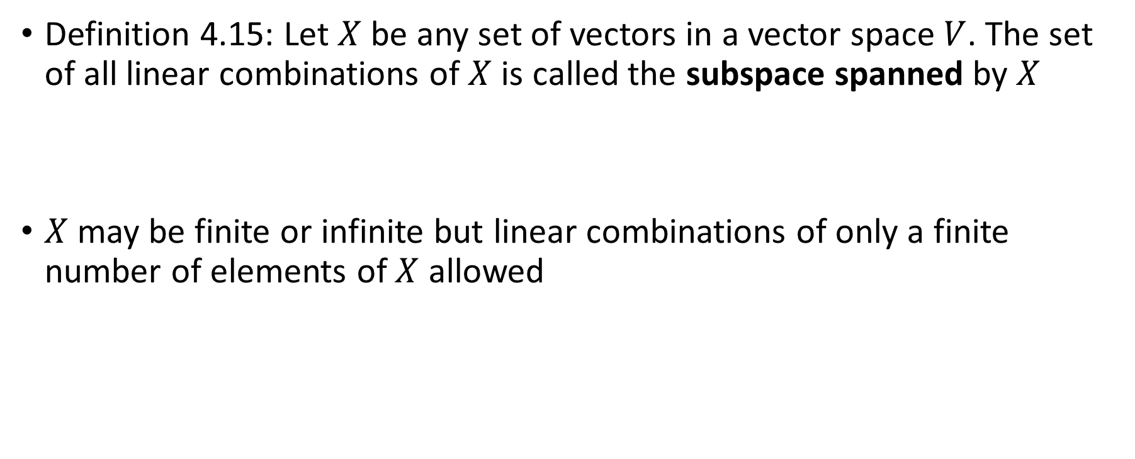
Span
Definition 4.15: Let $X$ be any set of vectors in a vector space $V$. The set of all linear combinations of $X$ is called the subspace spanned by $X$
$X$ may be finite or infinite but linear combinations of only a finite number of elements of $X$ allowed

Slide 13
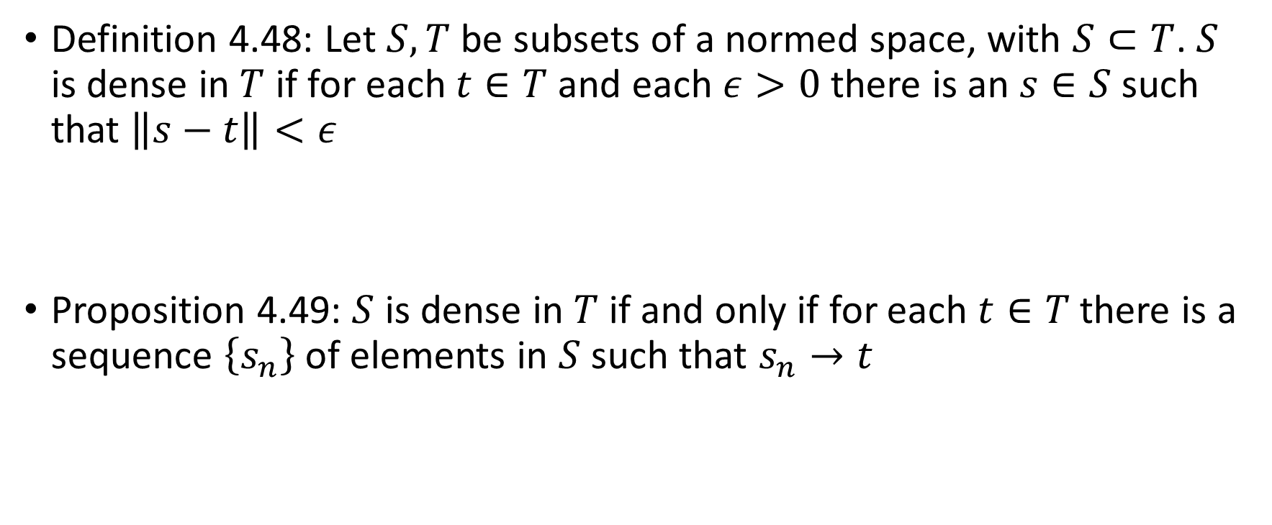
Dense Subsets
Definition 4.48: Let $S,T$ be subsets of a normed space, with $S⊂T$. $S$ is dense in $T$ if for each $t∈T$ and each $ε>0$ there is an $s∈S$ such that $\left\|s−t\right\|<ε$
Proposition 4.49: $S$ is dense in $T$ if and only if for each $t∈T$ there is a sequence $\left\{s_{n}\right\}$ of elements in $S$ such that $s_{n}→t$

Slide 14
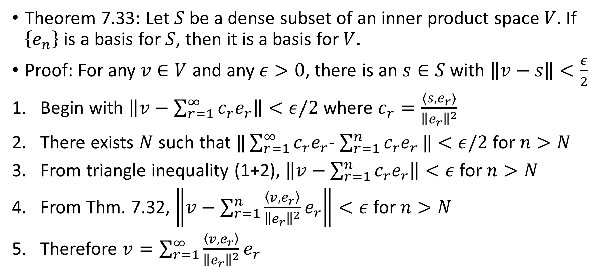
Dense Subsets and Basis
Theorem 7.33: Let $S$ be a dense subset of an inner product space $V$. If $\left\{e_{n}\right\}$ is a basis for $S$, then it is a basis for $V$.
Proof: For any $v∈V$ and any $ε>0$, there is an $s∈S$ with $\left\|v−s\right\|<\frac{ε}{2}$
Begin with $\left\|v−\sum_{r=1}^{∞}{c_{r}e_{r}}\right\|<ε/2$ where $c_{r}=\frac{⟨s,e_{r}⟩}{{\left\|e_{r}\right\|}^{2}}$
There exists $N$ such that $‖\sum_{r=1}^{∞}{c_{r}e_{r}}$- $\sum_{r=1}^{n}{c_{r}e_{r}}‖<ε/2$ for $n>N$
From triangle inequality (1+2), $\left\|v−\sum_{r=1}^{n}{c_{r}e_{r}}\right\|<ε$ for $n>N$
From Thm. 7.32, $\left\|v−\sum_{r=1}^{n}{\frac{\left\langle v,e_{r}\right\rangle }{{\left\|e_{r}\right\|}^{2}}e_{r}}\right\|<ε$ for $n>N$
Therefore $v=\sum_{r=1}^{∞}{\frac{\left\langle v,e_{r}\right\rangle }{{\left\|e_{r}\right\|}^{2}}e_{r}}$

Slide 15
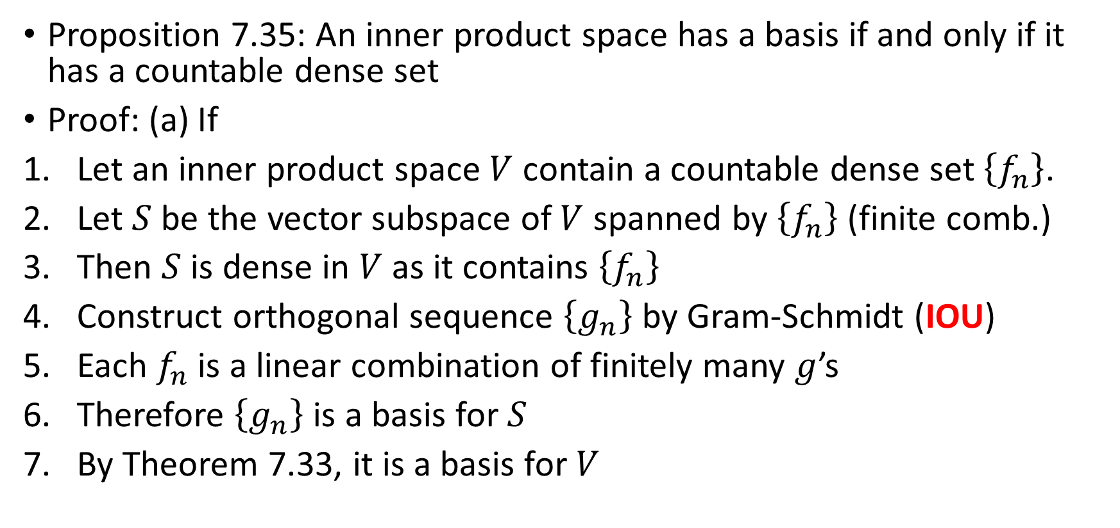
Existence of a Basis
Proposition 7.35: An inner product space has a basis if and only if it has a countable dense set
Proof: (a) If
Let an inner product space $V$ contain a countable dense set $\left\{f_{n}\right\}$.
Let $S$ be the vector subspace of $V$ spanned by $\left\{f_{n}\right\}$ (finite comb.)
Then $S$ is dense in $V$ as it contains $\left\{f_{n}\right\}$
Construct orthogonal sequence $\left\{g_{n}\right\}$ by Gram-Schmidt (IOU)
Each $f_{n}$ is a linear combination of finitely many $g$’s
Therefore $\left\{g_{n}\right\}$ is a basis for $S$
By Theorem 7.33, it is a basis for $V$

Slide 16
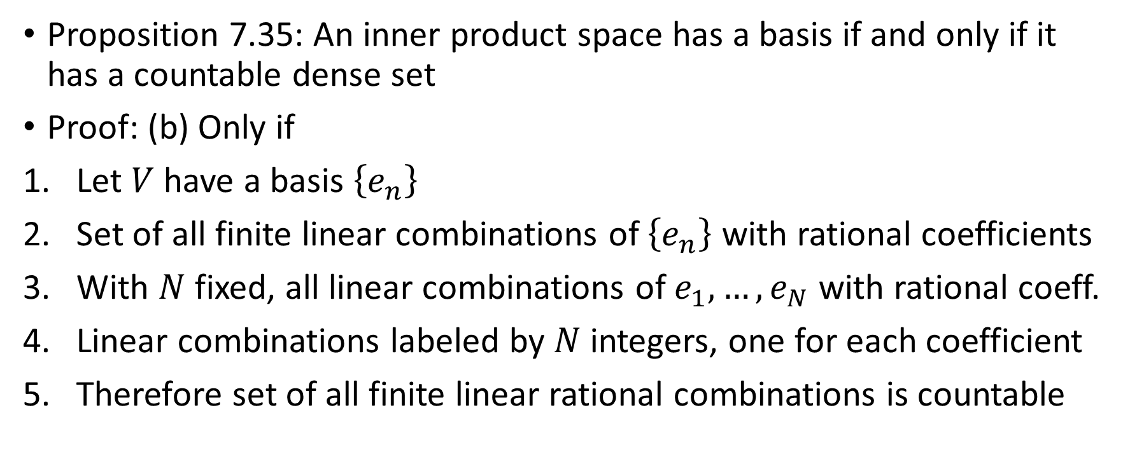
Existence of a Basis (contd.)
Proposition 7.35: An inner product space has a basis if and only if it has a countable dense set
Proof: (b) Only if
Let $V$ have a basis $\left\{e_{n}\right\}$
Set of all finite linear combinations of $\left\{e_{n}\right\}$ with rational coefficients
With $N$ fixed, all linear combinations of $e_{1},…,e_{N}$ with rational coeff.
Linear combinations labeled by $N$ integers, one for each coefficient
Therefore set of all finite linear rational combinations is countable

Slide 17
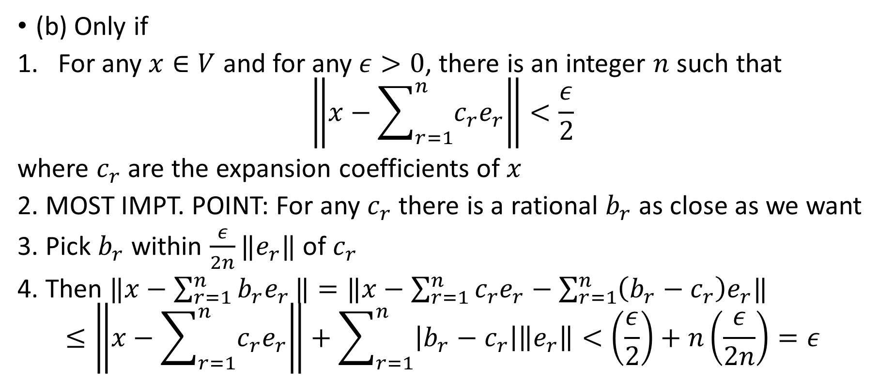
Existence of a Basis (contd.)
(b) Only if
For any $x∈V$ and for any $ε>0$, there is an integer $n$ such that
$$\left\|x−\sum_{r=1}^{n}{c_{r}e_{r}}\right\|<\frac{ε}{2}$$
where $c_{r}$ are the expansion coefficients of $x$
2. MOST IMPT. POINT: For any $c_{r}$ there is a rational $b_{r}$ as close as we want
3. Pick $b_{r}$ within $\frac{ε}{2n}‖e_{r}‖$ of $c_{r}$
4. Then $‖x−$ $\sum_{r=1}^{n}{b_{r}e_{r}}‖=‖x−\sum_{r=1}^{n}{c_{r}e_{r}}−\sum_{r=1}^{n}{\left(b_{r}−c_{r}\right)e_{r}‖}$
$$≤\left\|x−\sum_{r=1}^{n}{c_{r}e_{r}}\right\|+\sum_{r=1}^{n}{\left|b_{r}−c_{r}\right|\left\|e_{r}\right\|<\left(\frac{ε}{2}\right)+n\left(\frac{ε}{2n}\right)=ε}$$

Slide 18
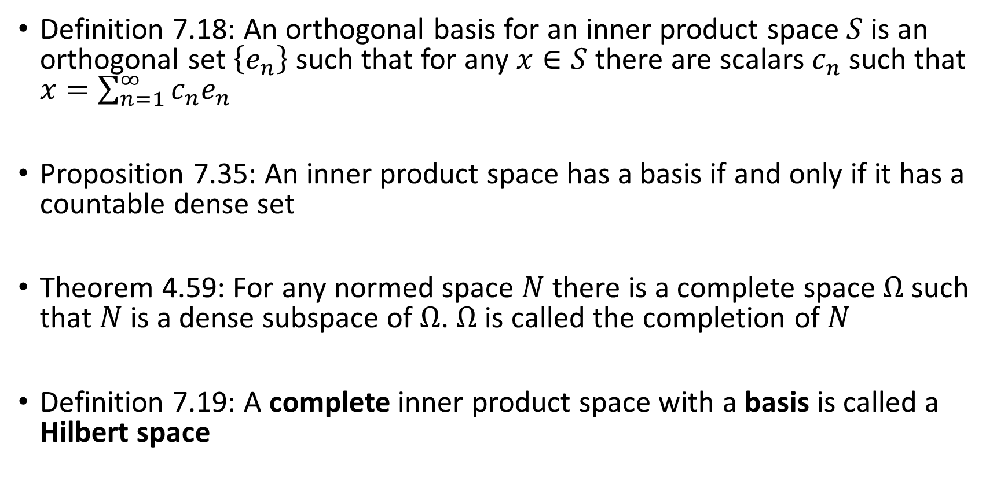
Hilbert Space
Definition 7.18: An orthogonal basis for an inner product space $S$ is an orthogonal set $\left\{e_{n}\right\}$ such that for any $x∈S$ there are scalars $c_{n}$ such that $x=\sum_{n=1}^{∞}{c_{n}e_{n}}$
Proposition 7.35: An inner product space has a basis if and only if it has a countable dense set
Theorem 4.59: For any normed space $N$ there is a complete space $Ω$ such that $N$ is a dense subspace of $Ω$. $Ω$ is called the completion of $N$
Definition 7.19: A complete inner product space with a basis is called a Hilbert space

